Slide 1
Cargo Hold Cleaning Solution for Cement Clinker
By Captain Nick Griffith
Hold Cleaning Technologies LLC
February 2018

Slide 2
Cement Clinker in the Cargo Hold
Cement clinker, also known as clinker, has the look and feel of dusty rocks.
The clinker cargo pile in the hold looks like a small hill i.e. high in the center and low around the perimeter of the hold.
It is common for up to 2/3 of the surfaces of the cargo holds to remain above the loaded clinker and be covered in clinker dust.
Until removed, the clinker dust on holds is always at risk of being exposed to moisture, causing it to bond solidly to these large, exposed elevated surfaces.
Significant areas of the cargo hold are covered in clinker dust

Slide 3
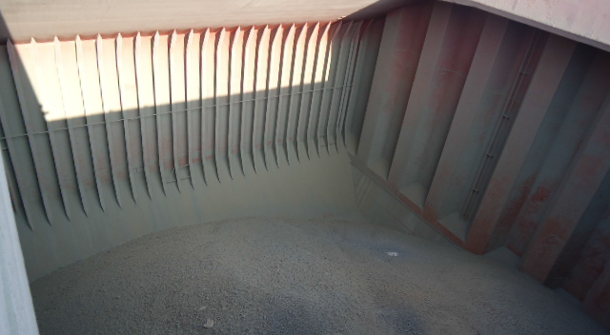
Typical Example of Dry Clinker Dust on Hold Surfaces
Clinker dust covers hold surfaces

Slide 4
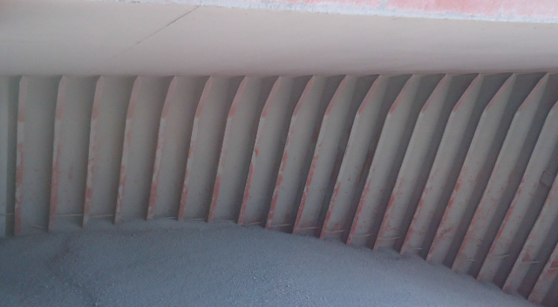
Close Up of Clinker Dust on Hold Surfaces
Clinker dust must be removed and the sooner the better.

Slide 5
The Risk of Delayed Cleaning
“Cement” including Cement Clinker is a binder; a substance that sets, hardens, and binds upon exposure to moisture.
The main risk associated with the carriage of clinker is that the exposed clinker dust will:
  Dampen, harden and bind to the hold.
  In a fused and hardened condition, removal is difficult & expensive.
  Unless it is removed, holds may fail cargo hold inspection.
Early removal of clinker dust will significantly reduce operating costs.

Slide 6
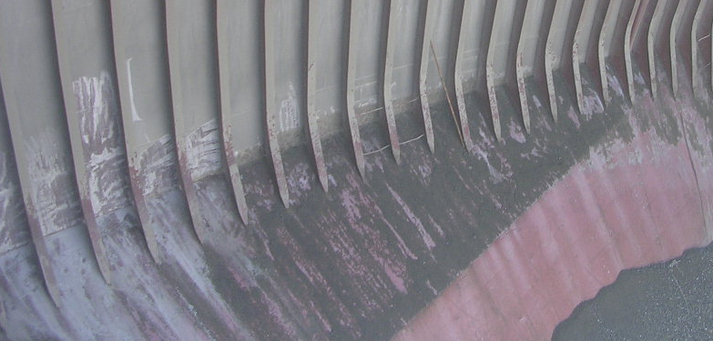
It is Usually Not Possible to Fully Remove Hardened Clinker Dust with Hand Tools
Such as Paint Scrapers or with Acid.
Typical example of hardened clinker dust on damp hold surfaces.

Slide 7
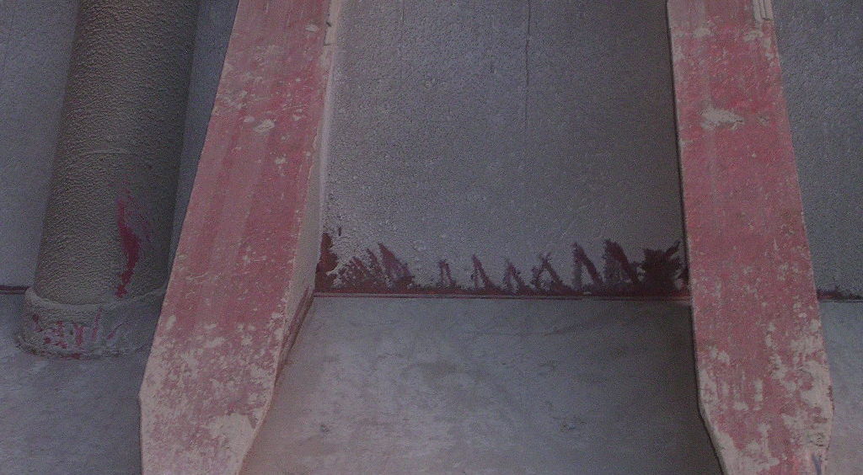
Hardened Cement Clinker Dust Residues are Very Difficult to Remove.
Close up of hardened clinker dust on hold surfaces.

Slide 8
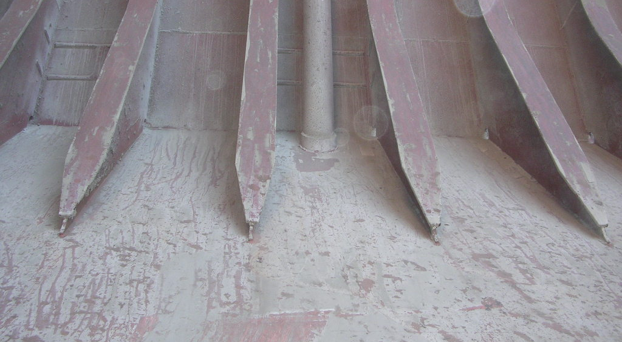
Removal of Hardened Clinker Dust Residue is Very Costly.
Hardened clinker dust showing vertical ‘streaks’ of condensed moisture.

Slide 9
It is Often Impossible to Keep Moisture Out of Cargo Holds:
The Problem Of Hardened Clinker Dust.
Cement Clinker sometimes arrives wet and is loaded into holds during wet conditions, especially during the summer Asian monsoon.
Each day a ship is underway the holds “sweat.” During warm days atmospheric moisture increases and during the cooler nights it condenses forming beads of “sweat” on the cold steel cargo hold surfaces, runs down the hold leaving water trails or “condensate streaks,” which hardens the clinker dust as it falls.
The longer the voyage, the bigger the problem.
After clinker dust hardens, removing it can become an operational “nightmare.” Usually only high pressure water blasting will fully remove it; a difficult, time consuming and very expensive task.
Most of the hard clinker dust will form high in the hold above the cargo line, so manlifts will be required for waterblasting.
A vessel without gear (cranes) may require floating barges and floating cranes to transport and load the manlifts, water blasters, waste residues etc. . Shore labor may be needed to operate lifts, water blasters, etc.
Our underway clinker cleaning kit eliminates these risks and costs.

Slide 10
Underway Air Flail Clinker Cleaning
Without Delay.
The cement clinker cleaning solution we propose is simple and prudent.
To avoid the risk and expense of clinker dust hardening to the exposed surfaces of the cargo hold above the cargo line we propose removing it as soon as possible after loading with our clinker cleaning kit.
This is accomplished by the crew standing on the cargo pile, and from this elevated position, raising and lowering the pole-mounted air flails which hit and remove the clinker dust.
Pole-mounted air flail cleaning system enables prompt underway cleaning
of holds to remove clinker dust without delay while it is easiest to remove.

Slide 11
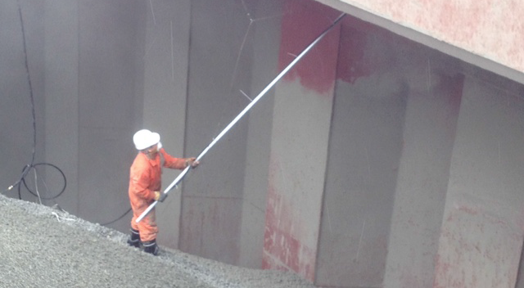
Air Flail Cleaning Clinker Underway
The clinker cargo pile offers crew with our pole-mounted tools convenient underway access for cleaning all exposed upper areas of the cargo hold.

Slide 12
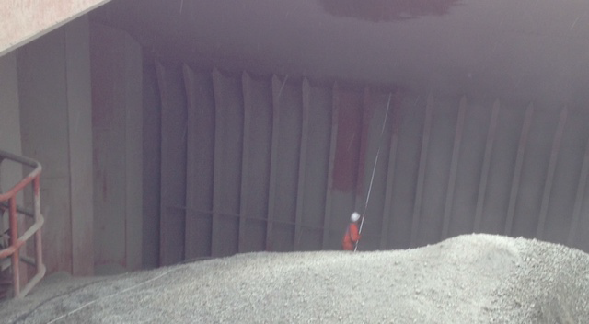
Air Flail Cleaning Clinker Underway
Large exposed areas of the hold are covered in clinker dust during transit. These areas are easy to reach with our pole-mounted air flails.

Slide 13
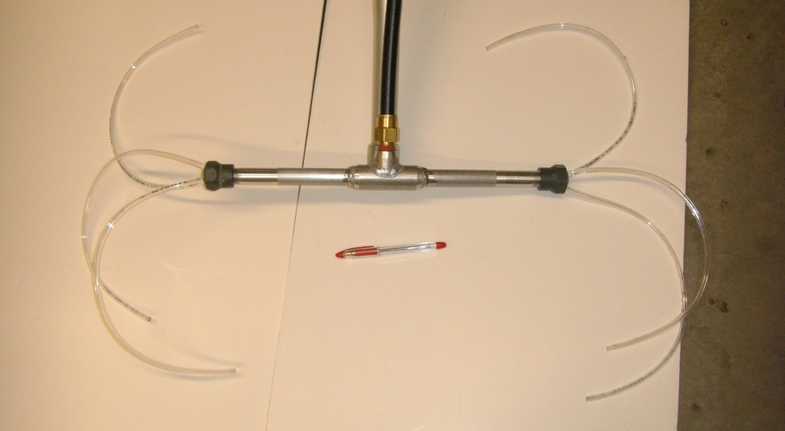
Pole Mounted Air Flails
The air flail tubes clean everything they hit, even removing clinker dust from the complex transverse overhead structures.

Slide 14
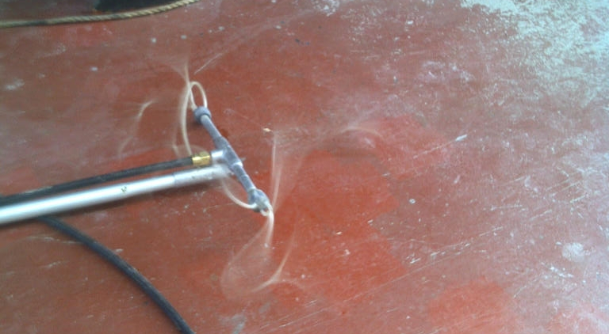
Pole Mounted Air Flails “Flailing”
Dr,y non-damaging air-powered air flail impact cleaning.

Slide 15
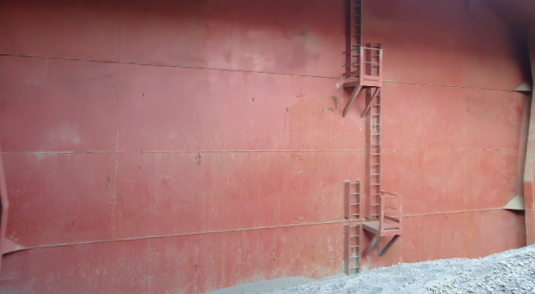
Cleaning Upper Areas Underway Reduces Cleaning Time at Discharge Port
Cargo hold after underway air flail cleaning

Slide 16
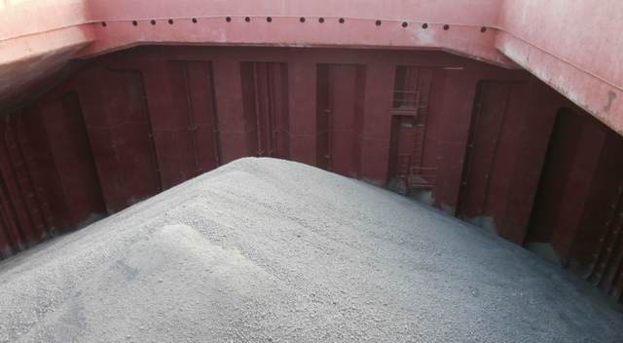
Cargo Hold After Underway Cleaning
Cleaning holds promptly while underway eliminates the risk
of the clinker dust hardening in transit.

Slide 17
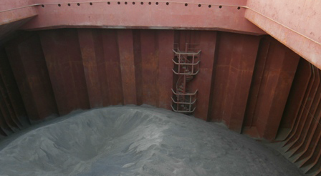
Cargo Hold After Underway Cleaning
Flexible air flail tubes clean better than manual tools or air wands.

Slide 18
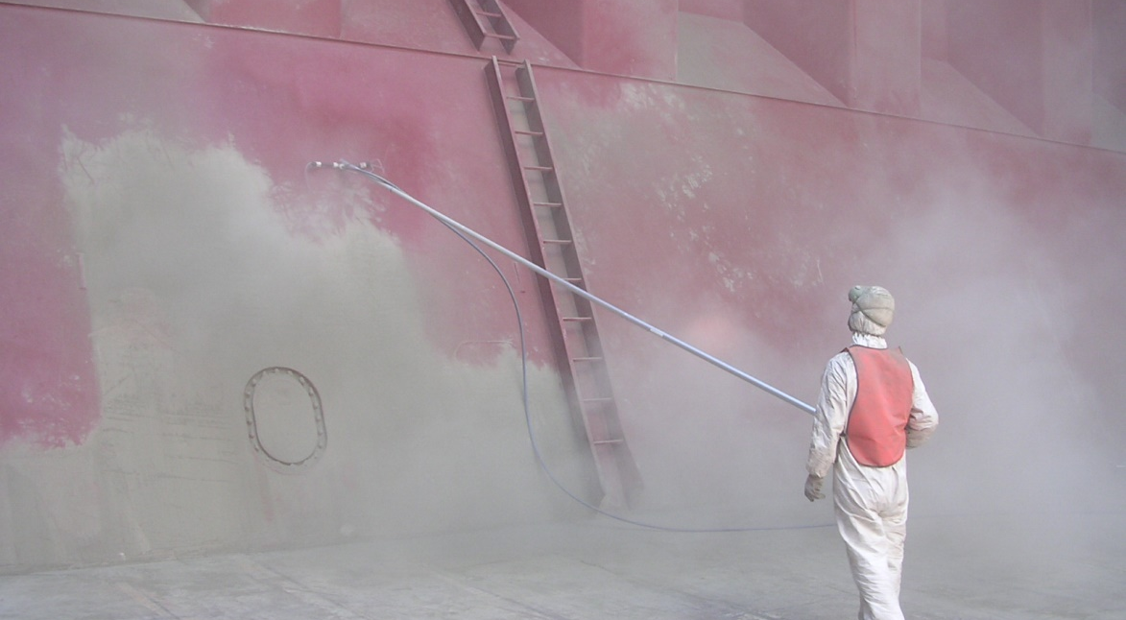
Cargo Hold Cleaning After Clinker Discharge
Effective Dry Cleaning is confirmed by the exposure of
the cargo hold paint previously covered in clinker dust.

Slide 19
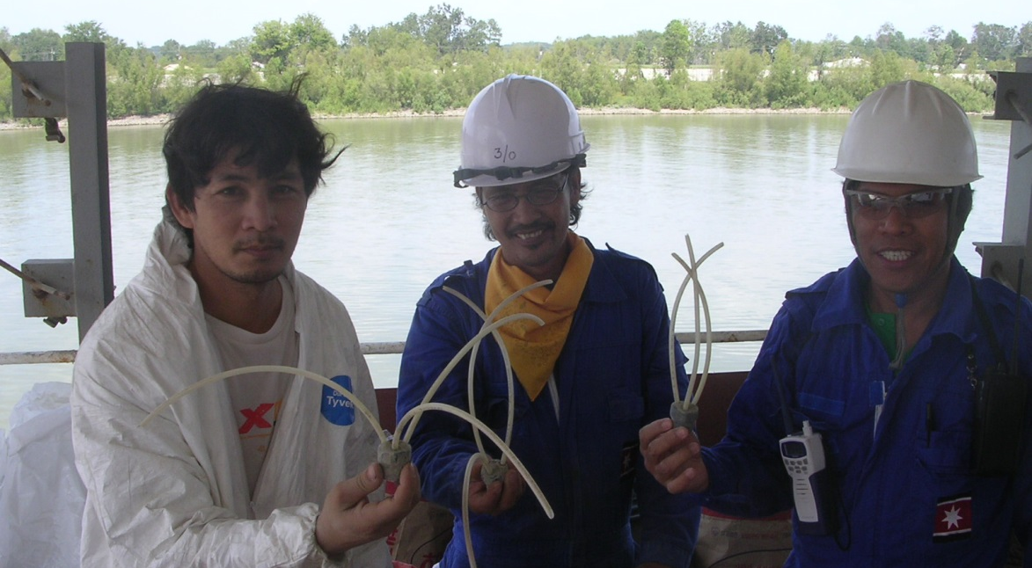
Sailors with Worn Air Flails
This cleaning system is well proven been used on vessels since 2005.

Slide 20
The Clinker Air Compressor System
Air flails in the Clinker Kit are powered by an air compressor system which consists of:
  An air compressor (unless the vessel has one that meets the below standards).
  A wire to connect the air compressor to the ship’s electrical system.
  Hoses to move the air from the air compressor to our air flails.
Most vessels are not fitted with a suitable air compressor for use with our Clinker Kit, one which supplies at least 117 PSI (8 bar) pressure and 94 cfm (2.7M3/min) volume.
In most cases usually two such air compressor systems are purchased and loaded onboard at or prior to arrival at the clinker load port. It is more cost efficient, but slower and less reliable, to purchase and use just one, rather than two, air compressors for cement clinker cleaning.

Slide 21
Additional Cleaning Costs We Help You Avoid
The actual cost of NOT promptly removing clinker dust can be
large and significant — our system helps you avoid this cost.
Off-hire losses: 3-5 days perhaps at $10,000.00 USD per day.
Outside contractor cost hold cleaning: Up to $12,000.00 USD per hold.
Floating barge for manlifts, if vessel has no gear: $25,000.00 USD per day.
Manlifts: $1,200.00 per week plus diesel.
Water Blaster Rental: If small, a few hundred dollars per machine per day.
Water Taxi for Outside Contractors: Varies by location; sometimes $2,500 per day.
Chemical Applicator kit and protective gear: $4-5,000.00 USD.
Chemicals/Acid: $1,000.00 USD per hold.
Crew Bonus: varies, but often $500.00 USD per hold.
Chemical waste water disposal: varies from zero, if dumped at sea, to $60,000.00 USD (West Coast North America).
Note: Prices will vary over time and location.
Promptly removing clinker dust with our air flail system will
help you avoid these very high cleaning costs.

Slide 22
WE OFFER YOU A NEW CLEANING OPTION: WHEN DO YOU WANT TO CLEAN YOUR CEMENT CLINKER HOLDS?
The single most important question an operators asks in deciding how or who cleans holds after Cement Clinker is: “What is the lowest cost cleaning option?”
What we offer is a new cleaning option: The option of cleaning soon after loading. WHEN DO YOU WANT TO CLEAN YOUR CEMENT CLINKER HOLDS? rather than how or who cleans them. It’s an important option because it offers you the option to save money.
You can think about it this way: If you attend a cement clinker discharge and the dust sticks to your car, as it has to ours, what would you do? Would you clean it off right away or wait a month or more? It’s the same with your holds. “Do you really want to wait a month or more to remove the cement clinker from your holds?” Now that you have a way to remove it quickly, “WHEN DO YOU WANT TO CLEAN YOUR CEMENT CLINKER HOLDS?”
Our system, the cement clinker cleaning kit, is not very expensive. We do not know how much yours costs, but we do know one thing for sure: Any cleaning system that does not remove the cement clinker dust soon after loading, before it has time to fuse to about 2/3 of the upper areas of your cargo holds, is more expensive than ours. Cleaning is really about only one thing: MONEY. If you use this system then you, like our other clients, will save money!

Slide 23
Hold Cleaning Technologies LLC -Patents
USA | 7,279,051 | Oct 9, 2007
USA | 8,025,070 | Sep 27, 2011
USA | 7,716,774 B2 | May 18, 2010
Singapore | 140,425 (WO 2007/027298) | March 31, 2009
Canada | 2,620,692 | Dec 7, 2010
Cleaning system is patented.

Slide 24
Please Note: This is a Clinker Cleaning Kit presentation ONLY.
We supply different types of kits to remove different types of cargo. This presentation does not apply to all of our kits. It only applies to our cement clinker kits intended for the removal of cement clinker dust residues while at or underway from load port and at discharge port.
We also supply kits for the removal of:
  Portland Cement after discharge at marine terminal, at local anchorage, or while underway to next load port.
  DRI-C after loading while underway to and at discharge port
  Slag; Fly Ash
  Rail Cars
  Cement Terminal Cleaning

Slide 25
Contact Information
Visit us online to learn more
www.holdcleaningtechnologiesllc.com

